Slide 1
HTML Basics

Slide 2
Basics
An HTML document is usually made up of a few things
Style
Scripts
Content

Slide 3
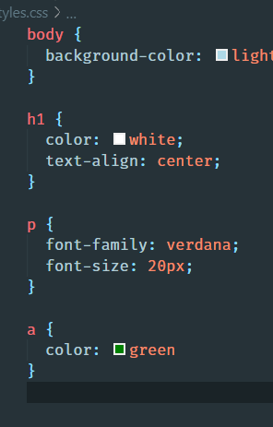
Style
If you want to switch links from being blue to being green you don’t want to have to do that one at a time
We’ll cover this later

Slide 4
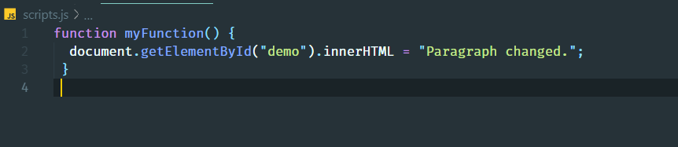
Scripts
Provide some level of interactivity the website
We’re not going to cover this at all

Slide 5
Content
What do you want to say?
What does it mean?

Slide 6
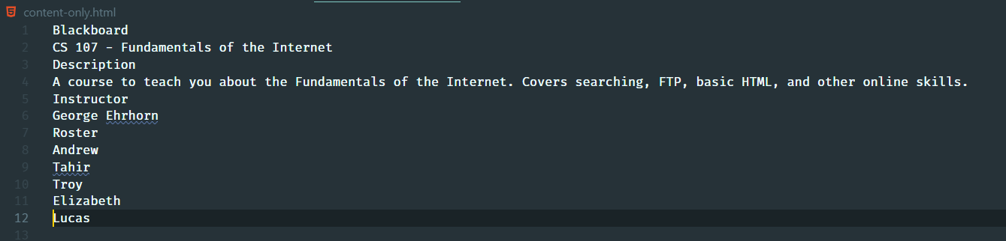
What do you want to say

Slide 7
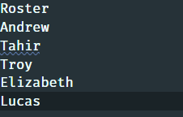
We need to give the document meaning
What do these two things mean?

Slide 8
DOCTYPE, HTML, HEAD, and BODY – the old way
We need to tell the browser what version of HTML we’re using.
DOCTYPE
We need to define the root element
HTML
We can define header information
HEAD
We need to say what goes on the page
BODY

Slide 9
A brief aside
I’m trying to teach you something very specific
How to get a basic webpage working
Some of what I’m teaching you isn’t required by HTML 5
But I want to show you because you may see things like this

Slide 10
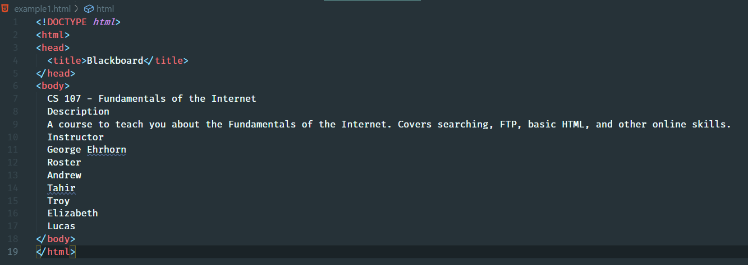
A little better

Slide 11
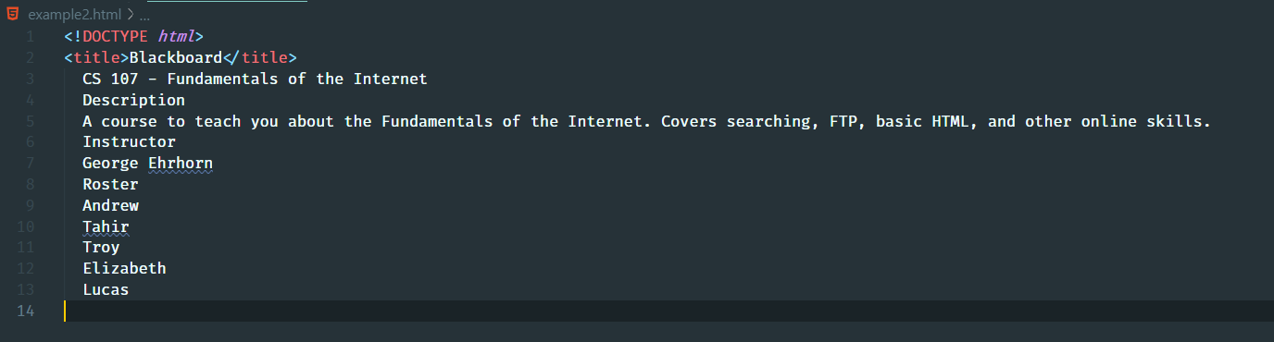
The newer way

Slide 12
But this still looks terrible

Slide 13
We need to provide meaning
Tags define meaning
Headings
Paragraphs
Lists
Links
Tags open and close…they surround what you’re defining meaning
<tag>stuff I’m surrounding</tag>
Tags can nest (tags within tags)
<outside><inside>Nested example</inside></outside>

Slide 14
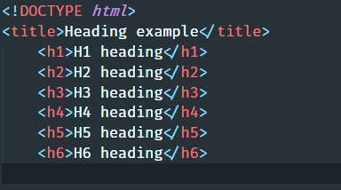
Heading Tags
Headings are defined with the <h1> to <h6> tags.
<h1> headings should be used for main headings, followed by <h2> headings, then the less important <h3>, and so on.

Slide 15
Headings
Where do we want headings in our example page?

Slide 16
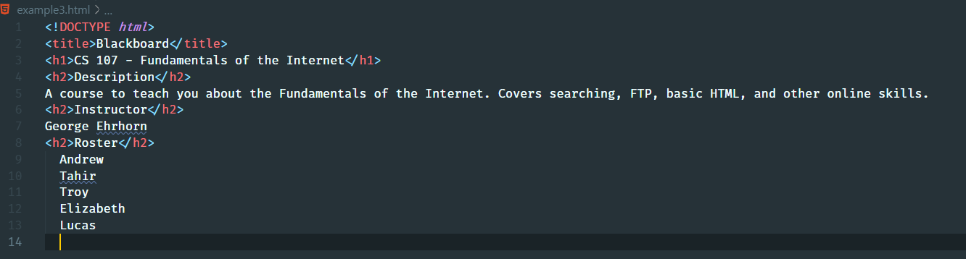
Headers added

Slide 17
HTML is bashful
You’re not allowed to have content that isn’t in a tag.
Our document is invalid
What about just normal text?
That’s a paragraph… we can use the <p> tag

Slide 18
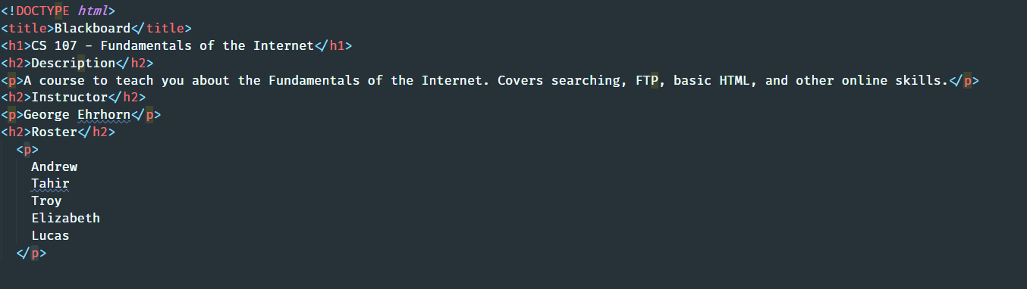
Paragraph tags

Slide 19
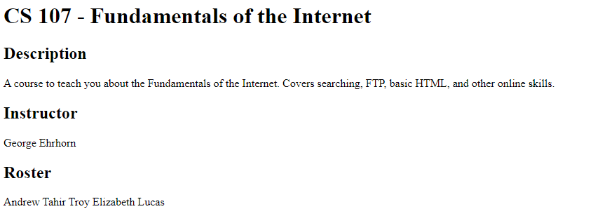
Looking way better

Slide 20
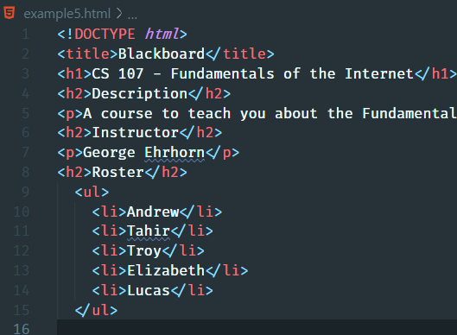
Lists
A list item is surrounded by a <li> tag
A list can be an ordered list <ol> or unordered list <ul>

Slide 21
Links – the anchor tag
For historical reasons links are done with an anchor <a> tag
Introduces a new concept…attributes
Surrounding text with an <a> tag won’t do anything
<a>George Ehrhorn</a> -- this is useless
We need to use an attribute to give the browser more information

Slide 22
Attributes…continued
All HTML elements can have attributes
Attributes provide additional information about an element
Attributes are always specified in the start tag
Attributes usually come in name/value pairs like: name="value"

Slide 23
Back to links
The attribute we’ll use the most in links is called href – hypertext reference
<a href=“https://www.cnn.com>CNN’s Homepage</a>

Slide 24
What about pictures?
We need a new tag
<img> is the tag
src is an attribute we’ll use
alt is another attribute we’ll use

Slide 25
Tables

